Slide 1
flex
Taught by Yossef Ayman Zedan

Slide 2
Enable flex behaviors
Apply display utilities to create a flexbox container and transform direct children elements into flex items. Flex containers and items are able to be modified further with additional flex properties.
<div class="d-flex p-2">I'm a flexbox container!</div> <div class="d-inline-flex p-2 bd-highlight">I'm an inline flexbox container!</div> Responsive variations also exist for .d-flex and .d-inline-flex.
.d-flex
.d-inline-flex
.d-sm-flex
.d-sm-inline-flex
.d-md-flex
And so on…

Slide 3
Direction
Set the direction of flex items in a flex container with direction utilities. In most cases you can omit the horizontal class here as the browser default is row. However, you may encounter situations where you needed to explicitly set this value (like responsive layouts).
Use .flex-row to set a horizontal direction (the browser default), or .flex-row-reverse to start the horizontal direction from the opposite side.

Slide 4
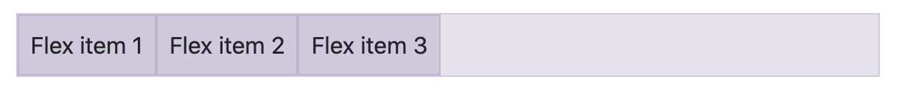
Example 1
<div class="d-flex flex-row bd-highlight mb-3"> <div class="p-2 bd-highlight">Flex item 1</div> <div class="p-2 bd-highlight">Flex item 2</div> <div class="p-2 bd-highlight">Flex item 3</div> </div>

Slide 5
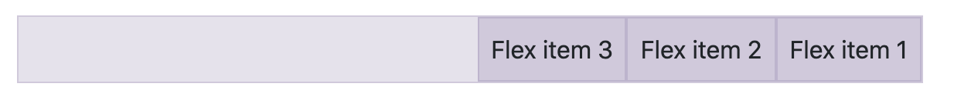
Example 2
<div class="d-flex flex-row-reverse bd-highlight"> <div class="p-2 bd-highlight">Flex item 1</div> <div class="p-2 bd-highlight">Flex item 2</div> <div class="p-2 bd-highlight">Flex item 3</div> </div>

Slide 6
Flex column
Use .flex-column to set a vertical direction, or .flex-column-reverse to start the vertical direction from the opposite side.

Slide 7
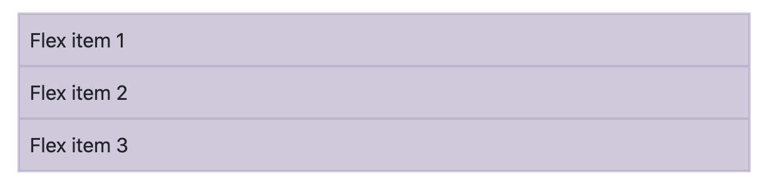
Flex column Example
<div class="d-flex flex-column bd-highlight mb-3"> <div class="p-2 bd-highlight">Flex item 1</div> <div class="p-2 bd-highlight">Flex item 2</div> <div class="p-2 bd-highlight">Flex item 3</div> </div>

Slide 8
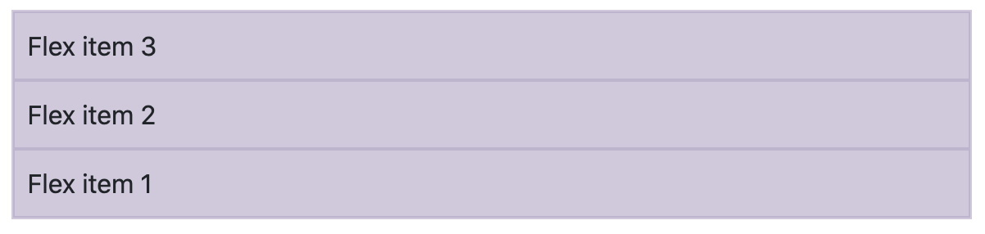
Flex column reverse Example
<div class="d-flex flex-column-reverse bd-highlight"> <div class="p-2 bd-highlight">Flex item 1</div> <div class="p-2 bd-highlight">Flex item 2</div> <div class="p-2 bd-highlight">Flex item 3</div> </div>

Slide 9
Responsive variations
.flex-row
.flex-row-reverse
.flex-column
.flex-column-reverse
.flex-sm-row
.flex-sm-row-reverse
.flex-sm-column
.flex-sm-column-reverse
And so on…

Slide 10
Justify content
Use justify-content utilities on flexbox containers to change the alignment of flex items on the main axis (the x-axis to start, y-axis if flex-direction: column). Choose from start (browser default), end, center, between, around, or evenly.
<div class="d-flex justify-content-start">...</div> <div class="d-flex justify-content-end">...</div> <div class="d-flex justify-content-center">...</div> <div class="d-flex justify-content-between">...</div> <div class="d-flex justify-content-around">...</div> <div class="d-flex justify-content-evenly">...</div>

Slide 11
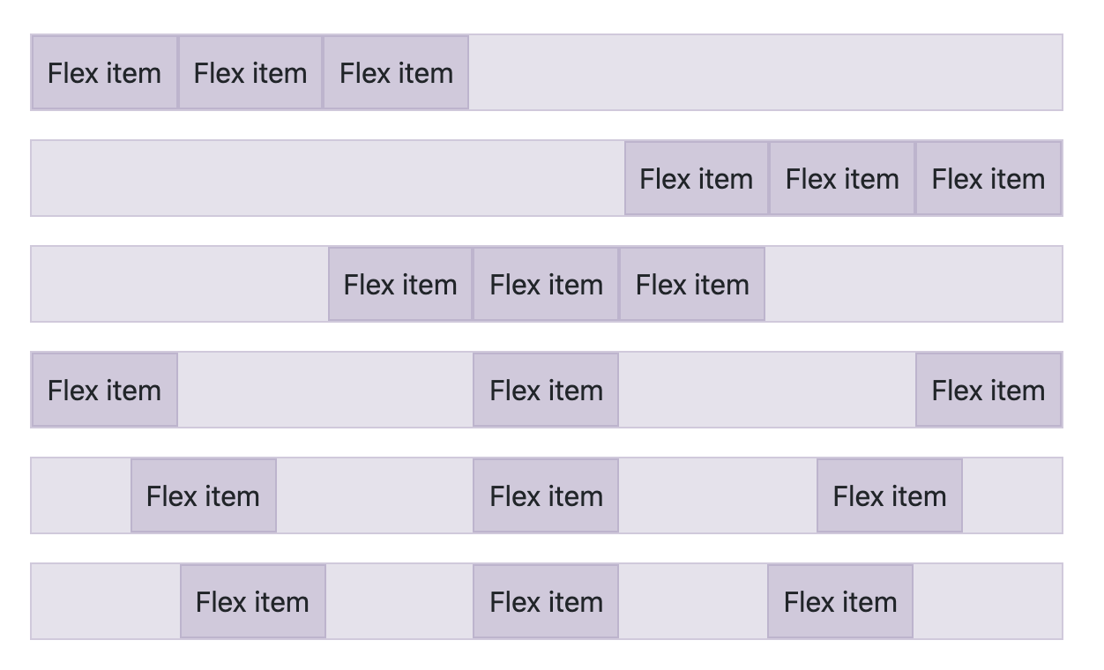
Justify content

Slide 12
Responsive justify-content
.justify-content-sm-start
.justify-content-sm-end
And so on…..

Slide 13
Align items
Use align-items utilities on flexbox containers to change the alignment of flex items on the cross axis (the y-axis to start, x-axis if flex-direction: column). Choose from start, end, center, baseline, or stretch (browser default).
<div class="d-flex align-items-start">...</div> <div class="d-flex align-items-end">...</div> <div class="d-flex align-items-center">...</div> <div class="d-flex align-items-baseline">...</div> <div class="d-flex align-items-stretch">...</div>

Slide 14
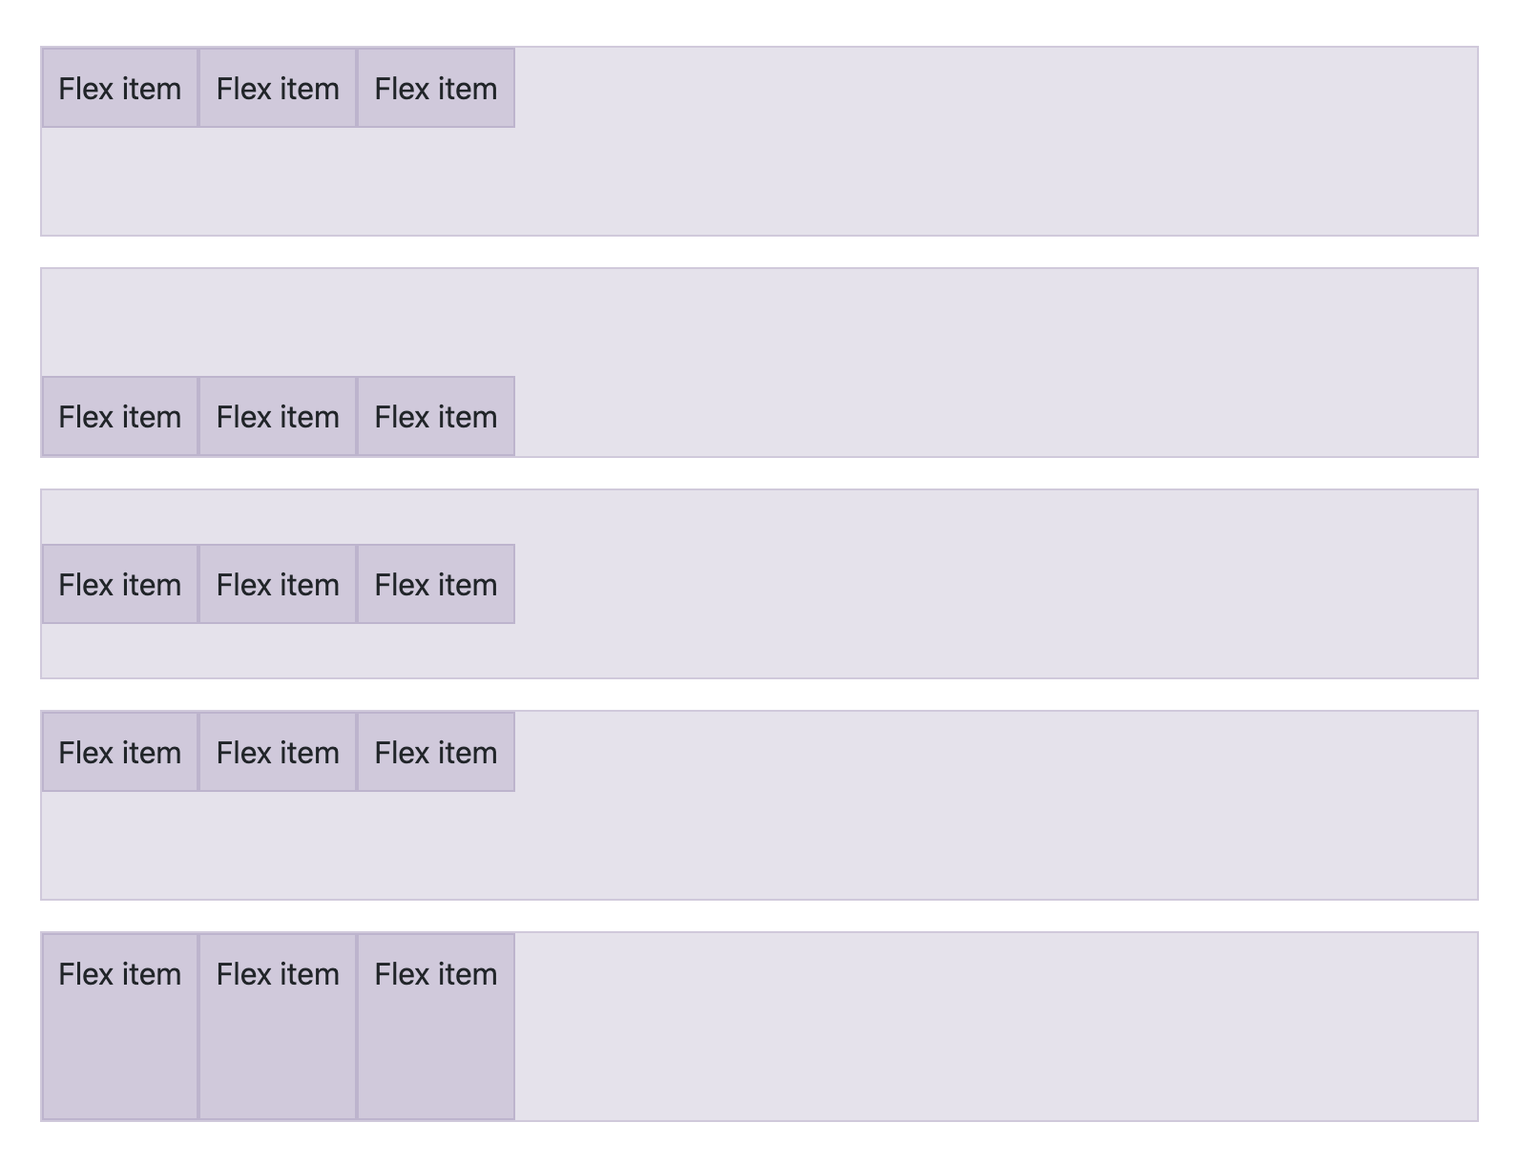
Align items

Slide 15
Responsive Align items
.align-items-sm-start
.align-items-md-start
.align-items-lg-start
.align-items-xl-start
.align-items-xxl-start

Slide 16
Align Self
Use align-self utilities on flexbox items to individually change their alignment on the cross axis (the y-axis to start, x-axis if flex-direction: column). Choose from the same options as align-items: start, end, center, baseline, or stretch (browser default).
<div class="align-self-start">Aligned flex item</div> <div class="align-self-end">Aligned flex item</div> <div class="align-self-center">Aligned flex item</div> <div class="align-self-baseline">Aligned flex item</div> <div class="align-self-stretch">Aligned flex item</div>

Slide 17
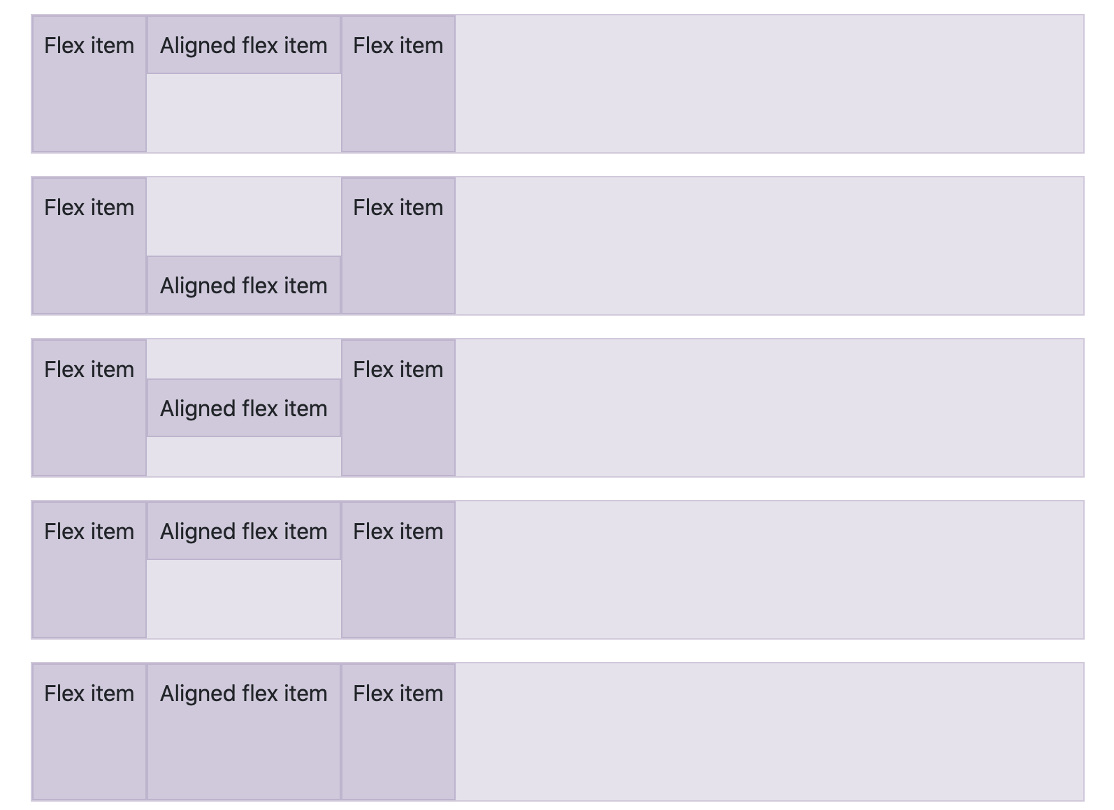
Align Self

Slide 18
Responsive Align Self
.align-self-sm-start
.align-self-md-start
.align-self-lg-start
.align-self-xl-start
.align-self-xxl-start

Slide 19
Fill
Use the .flex-fill class on a series of sibling elements to force them into widths equal to their content (or equal widths if their content does not surpass their border-boxes) while taking up all available horizontal space.
<div class="d-flex bd-highlight"> <div class="p-2 flex-fill bd-highlight">Flex item with a lot of content</div> <div class="p-2 flex-fill bd-highlight">Flex item</div> <div class="p-2 flex-fill bd-highlight">Flex item</div> </div>

Slide 20
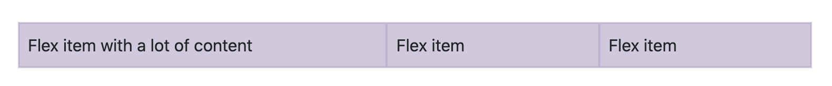
Fill
Use the .flex-fill class on a series of sibling elements to force them into widths equal to their content (or equal widths if their content does not surpass their border-boxes) while taking up all available horizontal space.
<div class="d-flex bd-highlight"> <div class="p-2 flex-fill bd-highlight">Flex item with a lot of content</div> <div class="p-2 flex-fill bd-highlight">Flex item</div> <div class="p-2 flex-fill bd-highlight">Flex item</div> </div>

Slide 21
Responsive Fill
.flex-fill
.flex-sm-fill
.flex-md-fill
.flex-lg-fill
.flex-xl-fill
.flex-xxl-fill

Slide 22
Grow and shrink
Use .flex-grow-* utilities to toggle a flex item’s ability to grow to fill available space. In the example below, the .flex-grow-1 elements uses all available space it can, while allowing the remaining two flex items their necessary space.
<div class="d-flex bd-highlight"> <div class="p-2 flex-grow-1 bd-highlight">Flex item</div> <div class="p-2 bd-highlight">Flex item</div> <div class="p-2 bd-highlight">Third flex item</div> </div>

Slide 23
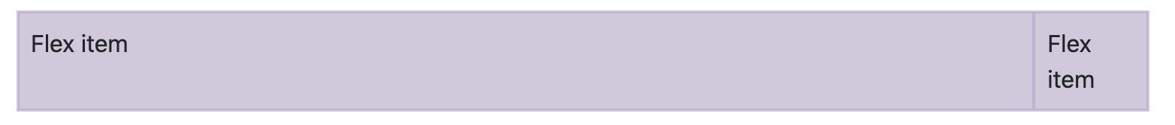
Grow and shrink
Use .flex-shrink-* utilities to toggle a flex item’s ability to shrink if necessary. In the example below, the second flex item with .flex-shrink-1 is forced to wrap its contents to a new line, “shrinking” to allow more space for the previous flex item with .w-100.
<div class="d-flex bd-highlight"> <div class="p-2 w-100 bd-highlight">Flex item</div> <div class="p-2 flex-shrink-1 bd-highlight">Flex item</div> </div>

Slide 24
Responsive Grow and shrink
.flex-{grow|shrink}-*
.flex-sm-{grow|shrink}-*
.flex-md-{grow|shrink}-*
.flex-lg-{grow|shrink}-*, xl and xxl

Slide 25
Auto margins
Flexbox can do some pretty awesome things when you mix flex alignments with auto margins. Shown below are three examples of controlling flex items via auto margins: default (no auto margin), pushing two items to the right (.me-auto), and pushing two items to the left (.ms-auto).

Slide 26
Basic flex
<div class="d-flex bd-highlight mb-3"> <div class="p-2 bd-highlight">Flex item</div> <div class="p-2 bd-highlight">Flex item</div> <div class="p-2 bd-highlight">Flex item</div> </div>

Slide 27
Margin right (end) auto
<div class="d-flex bd-highlight mb-3"> <div class="me-auto p-2 bd-highlight">Flex item</div> <div class="p-2 bd-highlight">Flex item</div> <div class="p-2 bd-highlight">Flex item</div> </div>

Slide 28
Margin left (start) auto
<div class="d-flex bd-highlight mb-3"> <div class="p-2 bd-highlight">Flex item</div> <div class="p-2 bd-highlight">Flex item</div> <div class="ms-auto p-2 bd-highlight">Flex item</div> </div>

Slide 29
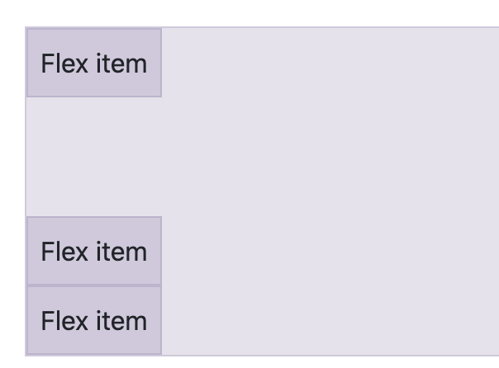
With align items
Vertically move one flex item to the top or bottom of a container by mixing align-items, flex-direction: column, and margin-top: auto or margin-bottom: auto.
<div class="d-flex align-items-start flex-column bd-highlight mb-3" style="height: 200px;"> <div class="mb-auto p-2 bd-highlight">Flex item</div> <div class="p-2 bd-highlight">Flex item</div> <div class="p-2 bd-highlight">Flex item</div> </div>

Slide 30
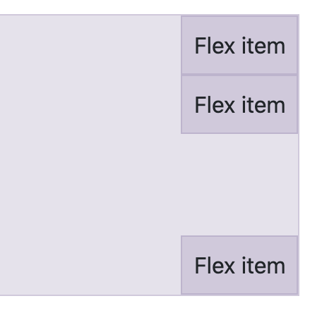
With align items
<div class="d-flex align-items-end flex-column bd-highlight mb-3" style="height: 200px;"> <div class="p-2 bd-highlight">Flex item</div> <div class="p-2 bd-highlight">Flex item</div> <div class="mt-auto p-2 bd-highlight">Flex item</div> </div>

Slide 31
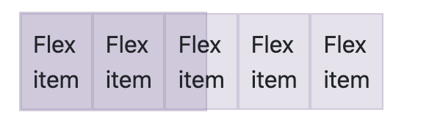
Wrap
Change how flex items wrap in a flex container. Choose from no wrapping at all (the browser default) with .flex-nowrap, wrapping with .flex-wrap, or reverse wrapping with .flex-wrap-reverse.
<div class="d-flex flex-nowrap” style=“width: 100px;”> ... </div>

Slide 32
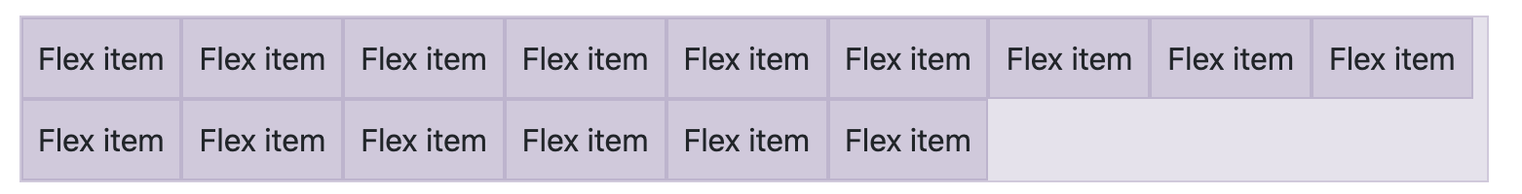
Flex Wrap
<div class="d-flex flex-wrap"> …
</div>

Slide 33
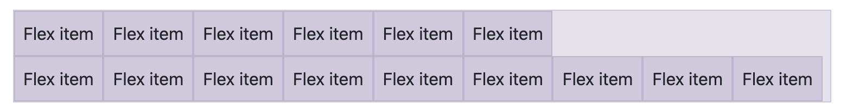
Flex Wrap reverse
To wrap in the opposite direction
<div class="d-flex flex-wrap-reverse"> …
</div>

Slide 34
Responsive flex wrap
.flex-sm-wrap
.flex-sm-wrap-reverse
.flex-md-nowrap
.flex-md-wrap
And so on…

Slide 35
Order
Change the visual order of specific flex items with a handful of order utilities. bootstrap only provides options for making an item first or last, as well as a reset to use the DOM order. As order takes any integer value from 0 to 5, add custom CSS for any additional values needed.
<div class="d-flex flex-nowrap bd-highlight"> <div class="order-3 p-2 bd-highlight">First flex item</div> <div class="order-2 p-2 bd-highlight">Second flex item</div> <div class="order-1 p-2 bd-highlight">Third flex item</div> </div>

Slide 36
Responsive Order
.order-sm-*
.order-md-*
.order-lg-*
.order-xl-*
.order-xxl-*

Slide 37
Order first and last
Additionally there are also responsive .order-first and .order-last classes that change the order of an element by applying order: -1 and order: 6, respectively.
.order-first
.order-last
.order-sm-first/last
.order-md-first/last
.order-lg-first/last
.order-xl-first/last
.order-xxl-first/last

Slide 38
Align content
Use align-content utilities on flexbox containers to align flex items together on the cross axis. Choose from start (browser default), end, center, between, around, or stretch. To demonstrate these utilities, we’ve enforced flex-wrap: wrap and increased the number of flex items.
Heads up! This property has no effect on single rows of flex items.
<div class="d-flex align-content-start flex-wrap"> …
</div>

Slide 39
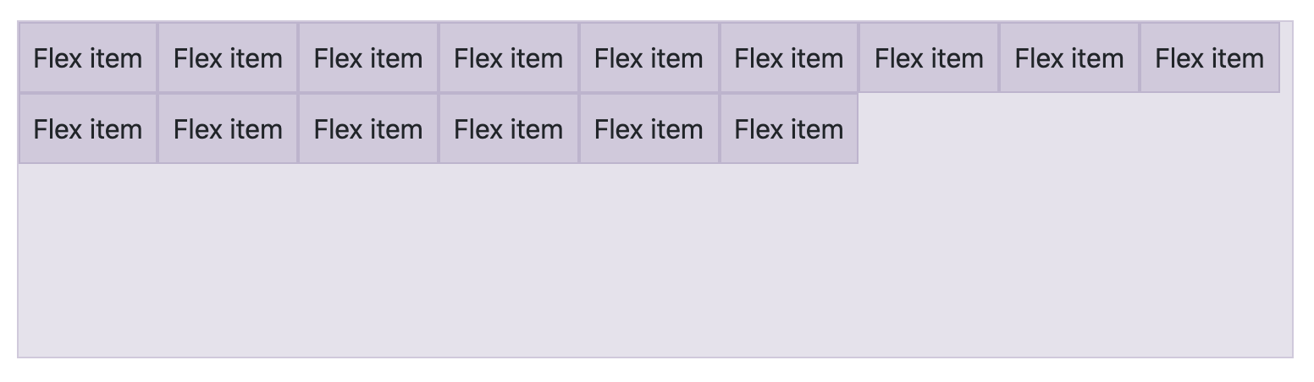
Align content

Slide 40
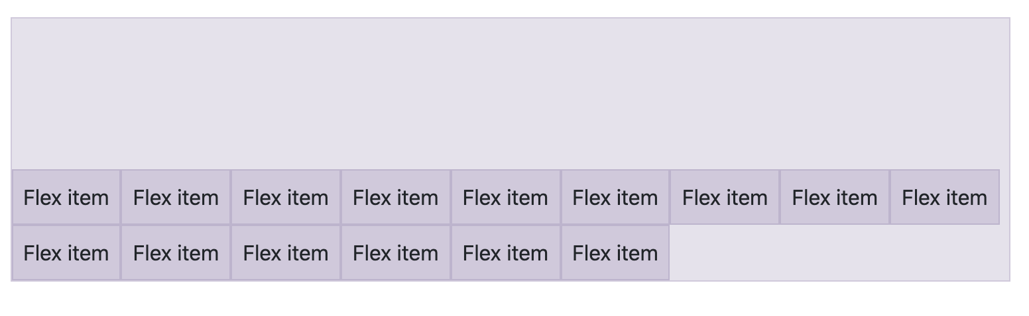
Align content
<div class="d-flex align-content-end flex-wrap">...</div>

Slide 41
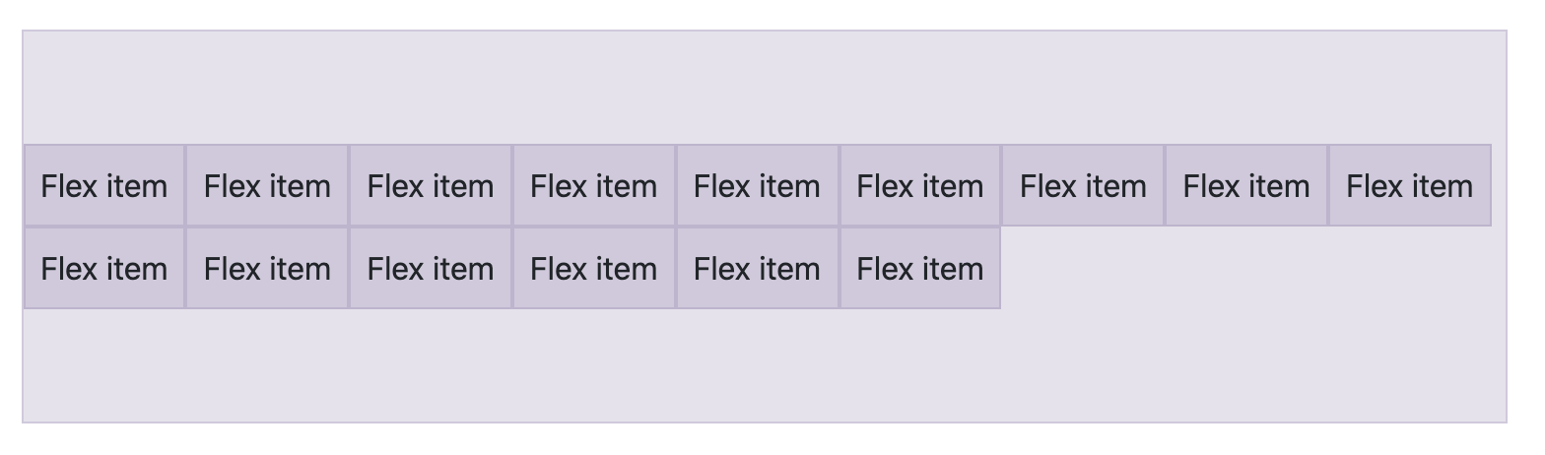
Align content
<div class="d-flex align-content-center flex-wrap">...</div>

Slide 42
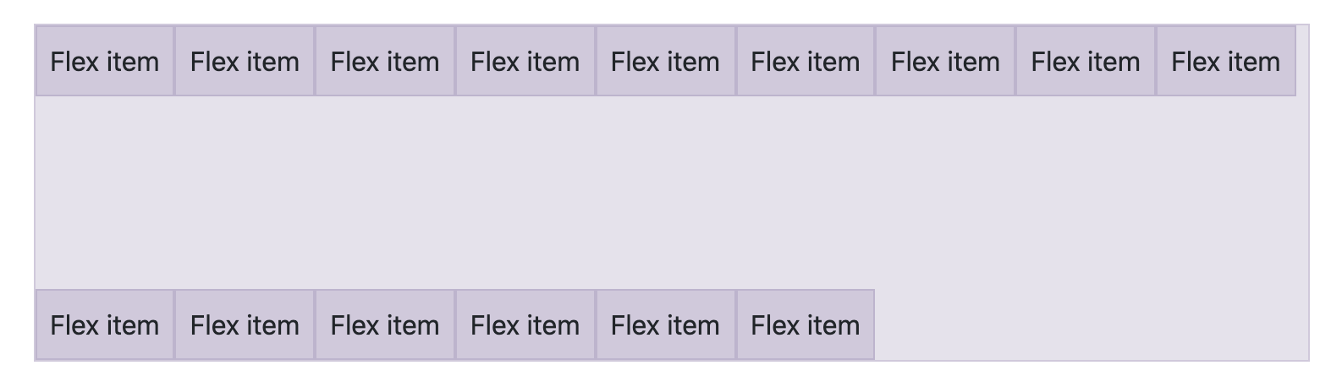
Align content
<div class="d-flex align-content-between flex-wrap">...</div>

Slide 43
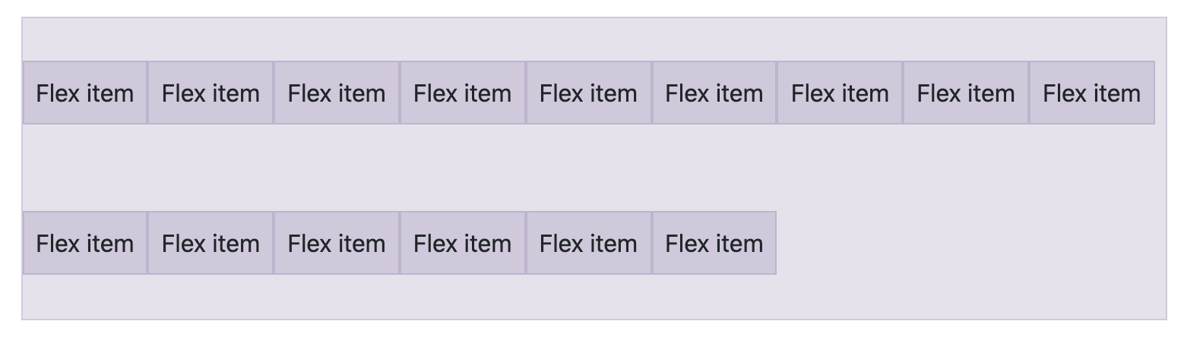
Align content
<div class="d-flex align-content-around flex-wrap">...</div>

Slide 44
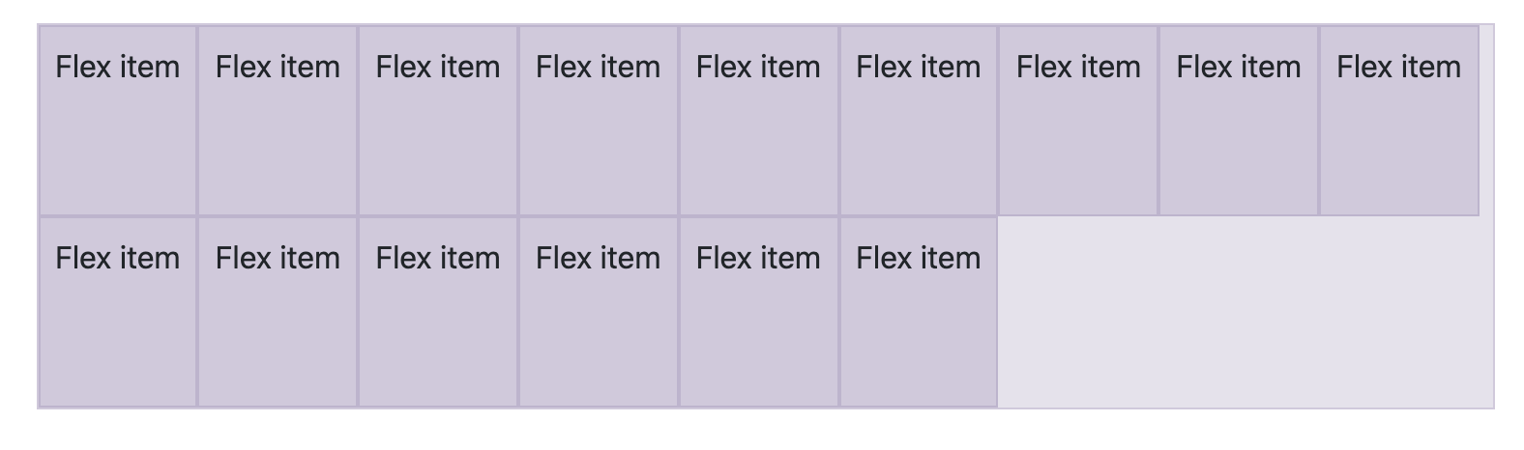
Align content
<div class="d-flex align-content-stretch flex-wrap">...</div>

Slide 45
Responsive Align content
.align-content-breakpoint-property

Slide 46

Media object
<div class="d-flex"> <div class="flex-shrink-0"> <img src="..." alt="..."> </div> <div class="flex-grow-1 ms-3"> This is some content from a media component. You can replace this with any content and adjust it as needed. </div> </div>

Slide 47

Media object
And say you want to vertically center the content next to the image, just add align-items-center after d-flex

